Slide 1


Exploring the career performance of ODI Cricketers

Slide 2
01
Team Members
Bala Harinadh Palavelli
Suresh Sindam
Anilkumar Palavelli
Bhanuteja Chitrala
Krishna Sai Balupari
Samyuktha Pandula
RajaShree Bokka

Slide 3
Project Objective
The main objective of this research looks at all of the information about Indian cricket players' careers in One Day International (ODI) games. It looks at things like games played, runs made, hitting rates, and bowling figures. The study shows how Indian players have contributed to ODI cricket in the past and present by looking at trends and important events. It is a great resource for cricket fans and students who want to learn about how India's cricketing skills have changed over time.

Slide 4
01
Dataset
Data Source link : Kaggle
https://www.kaggle.com/datasets/hverified/cricket-players-odi/data

Slide 5
Team Collaboration
01
Selecting Data Set, Discussing and figuring out the goals (Everyone)
02
Cleaning the data set (Bala Harinadh, Samyuktha, RajaShree)
03
Coding Using Hadoop Map reduce(Bhanuteja, Samyuktha)
04
Reporting and Visualizing the Goals(Anilkumar, Krishna Sai, Suresh)
05
Final Documentation (Everyone) -> 100%

Slide 6
Methodologies and Tools
Methodologies
Tools
Data preparation
Programming language: Java
Data analysis
Data visualization: Tableau
Visualization
Distributed computing framework: Hadoop MapReduce

Slide 7
01
Data
Extraction
from Kaggle
Data
Pre - Processing
Architecture
Diagram
MapReduce
Jobs
Post
Processing & Analysis
Reporting & Visualization

Slide 8
01
Goals
Goal 1: The goal is to visualize the players who are good at both batting and bowling, that is regular all- rounders (whose bowling and batting average greater than 40).
Goal 2: The goal is to visualize all the bowlers who bowled more than 150 maiden overs.
Goal 3: To visualize all the players who scored more than 20 centuries.
Goal 4: To visualize all the players who took more than 250 wickets in ODI cricket.
Goal 5: To visualize all the players whose took more than 145 catches.
Goal 6: The goal is to visualize all the players who remained not out in more than 50 matches.

Slide 9
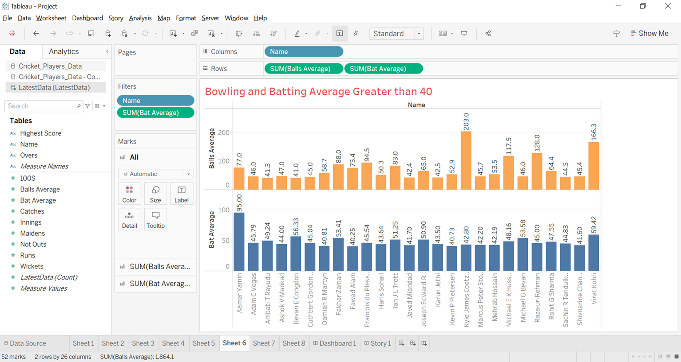
Goal 1
The goal is to visualize the players who are good at both batting and bowling that is regular all-rounders (whose bowling and batting average greater than 40)

Slide 10
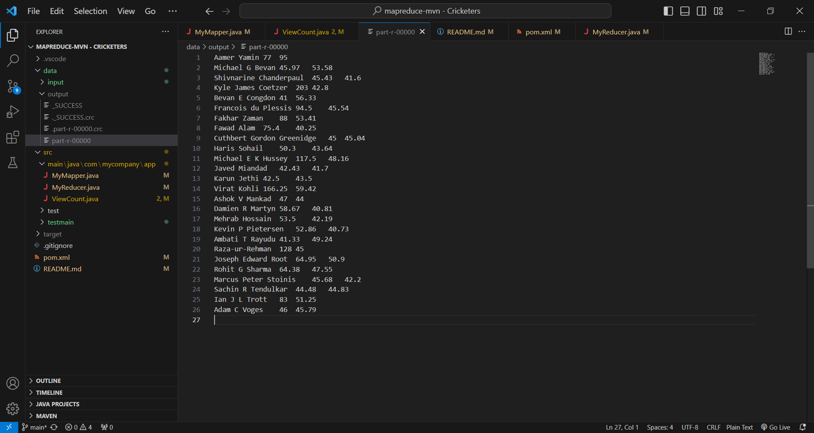
Goal 1(MapReduce Output)

Slide 11
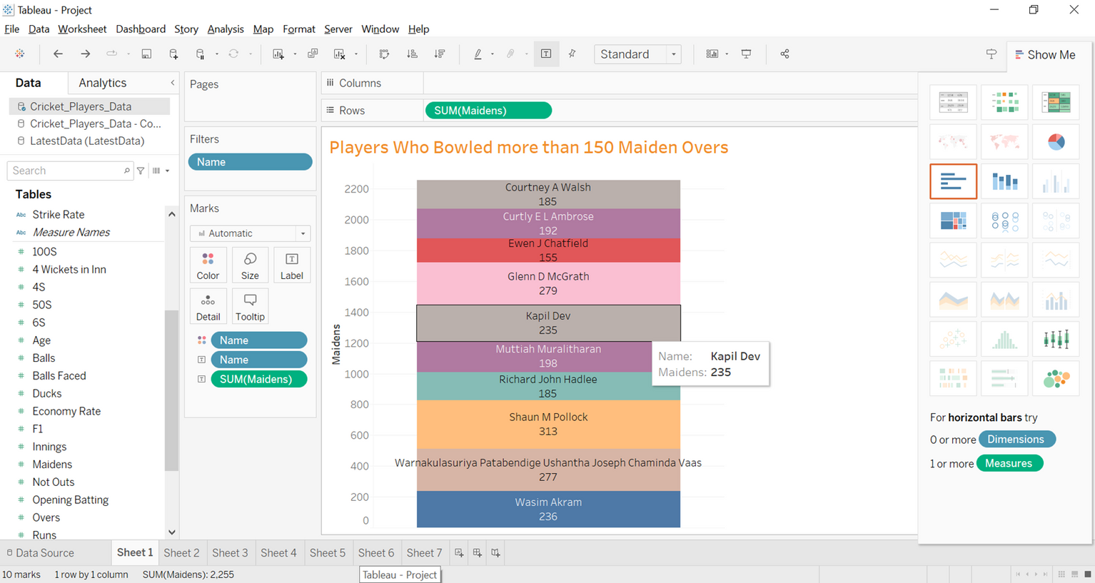
Goal 2
The goal is to visualize all the bowlers who bowled more than 150 maiden overs.

Slide 12
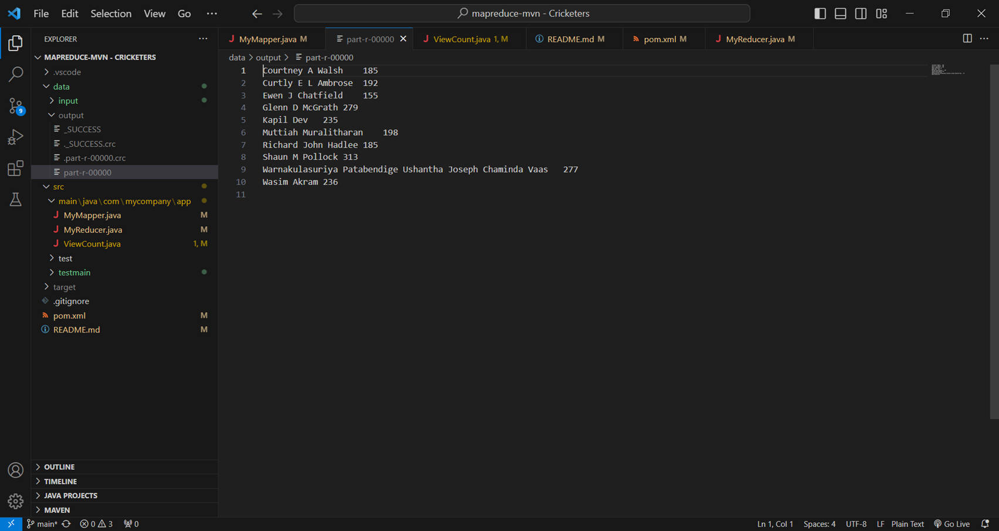
Goal 2(MapReduce Output)

Slide 13
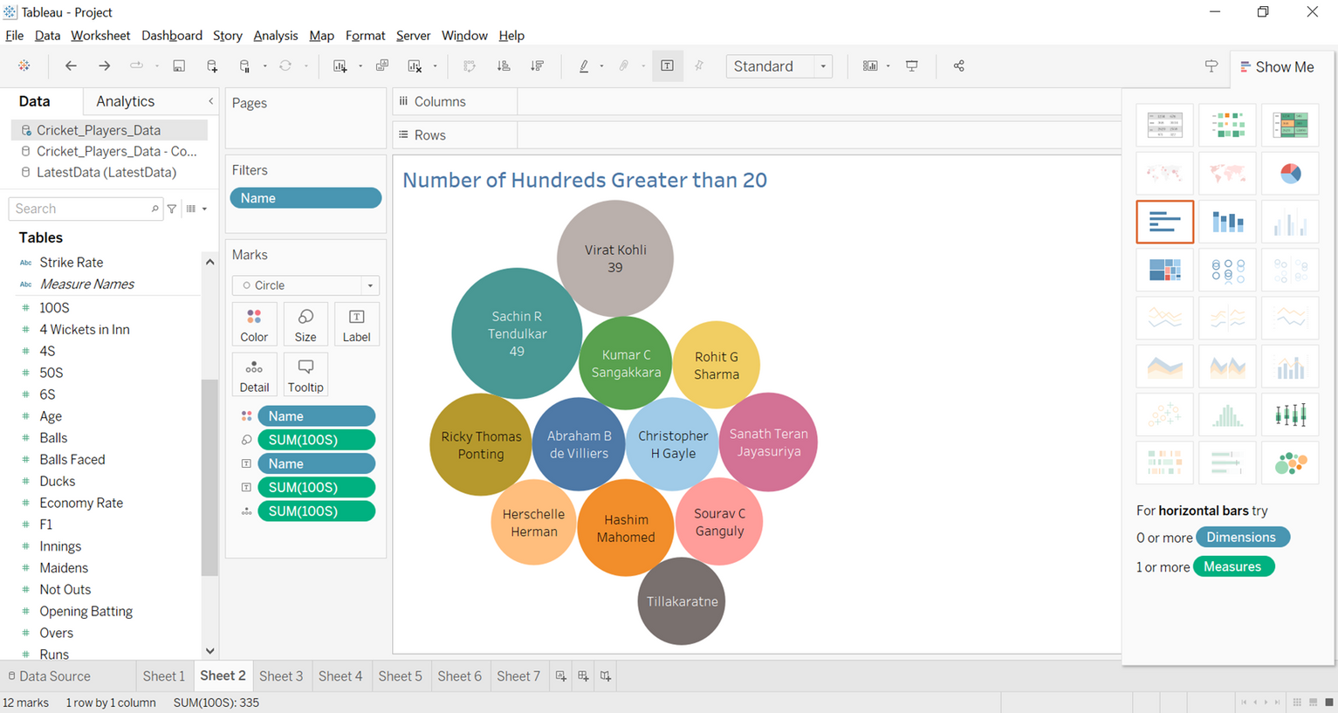
Goal 3
To visualize all the players who scored more than 20 centuries.

Slide 14
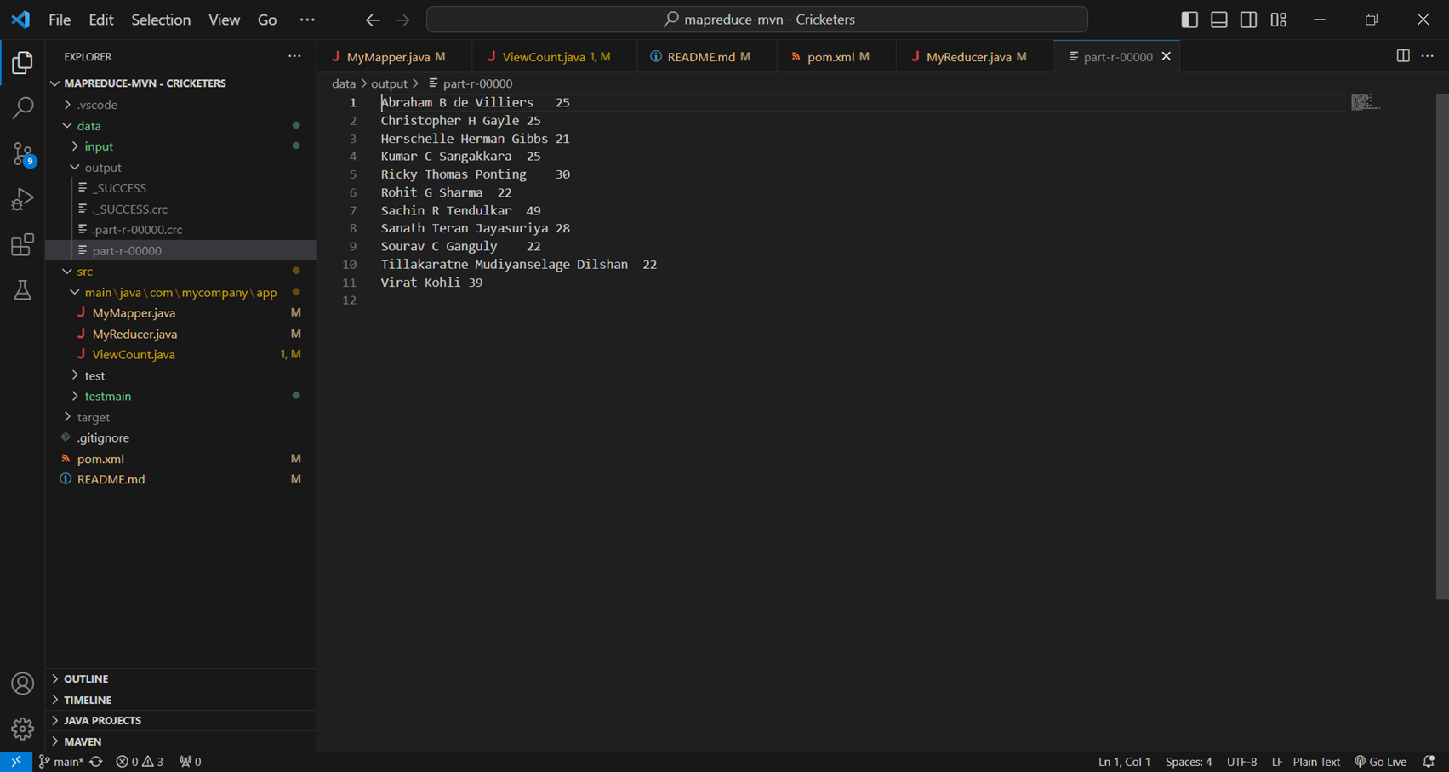
Goal 3(MapReduce Output)

Slide 15
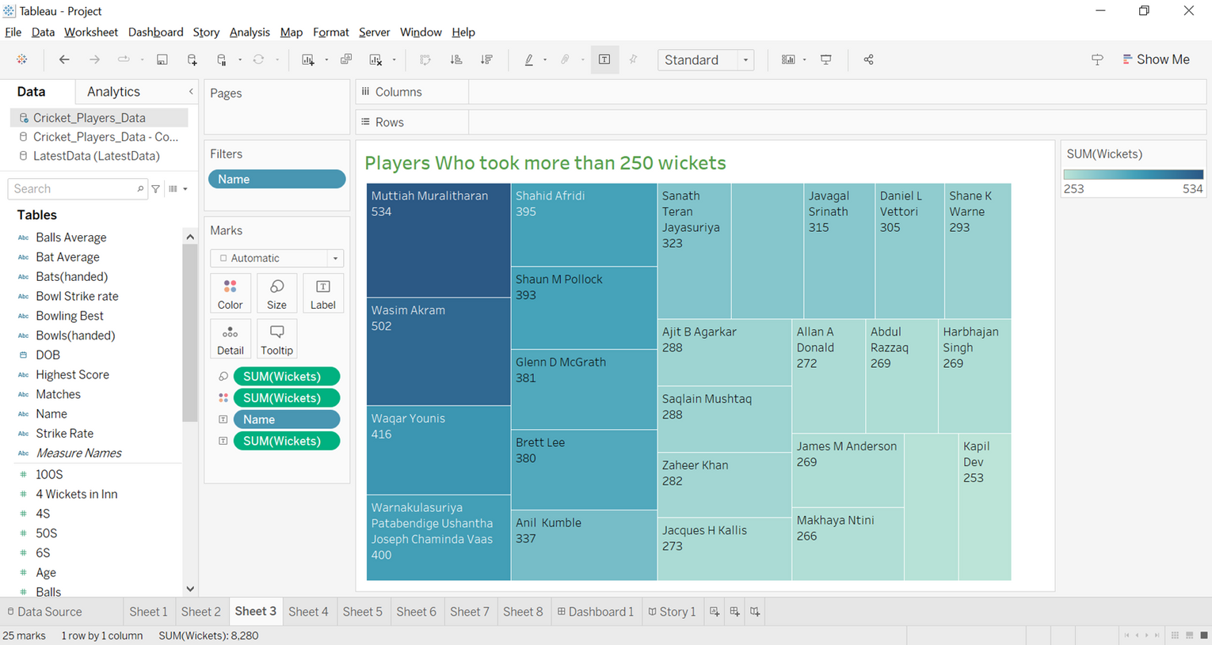
Goal 4
To visualize all the players who took more than 250 wickets in ODI cricket.

Slide 16
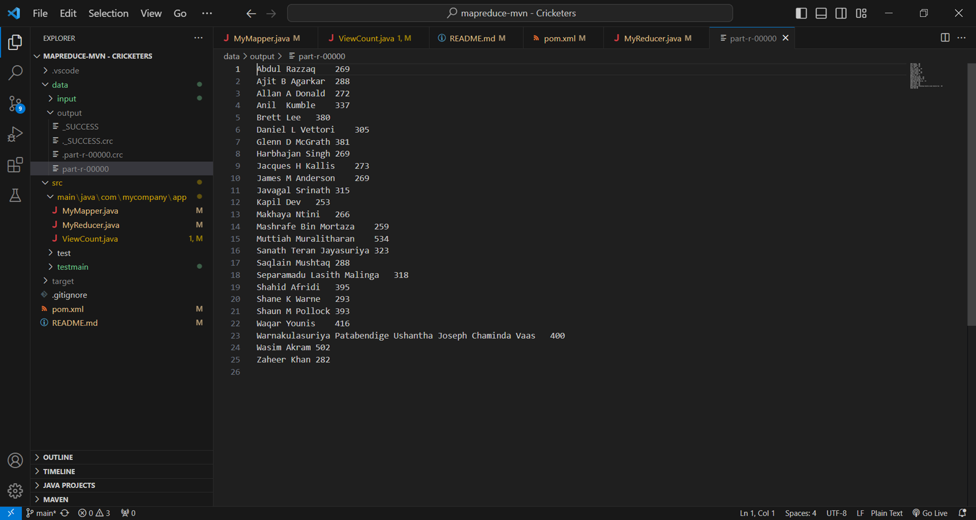
Goal 4(MapReduce Output)

Slide 17
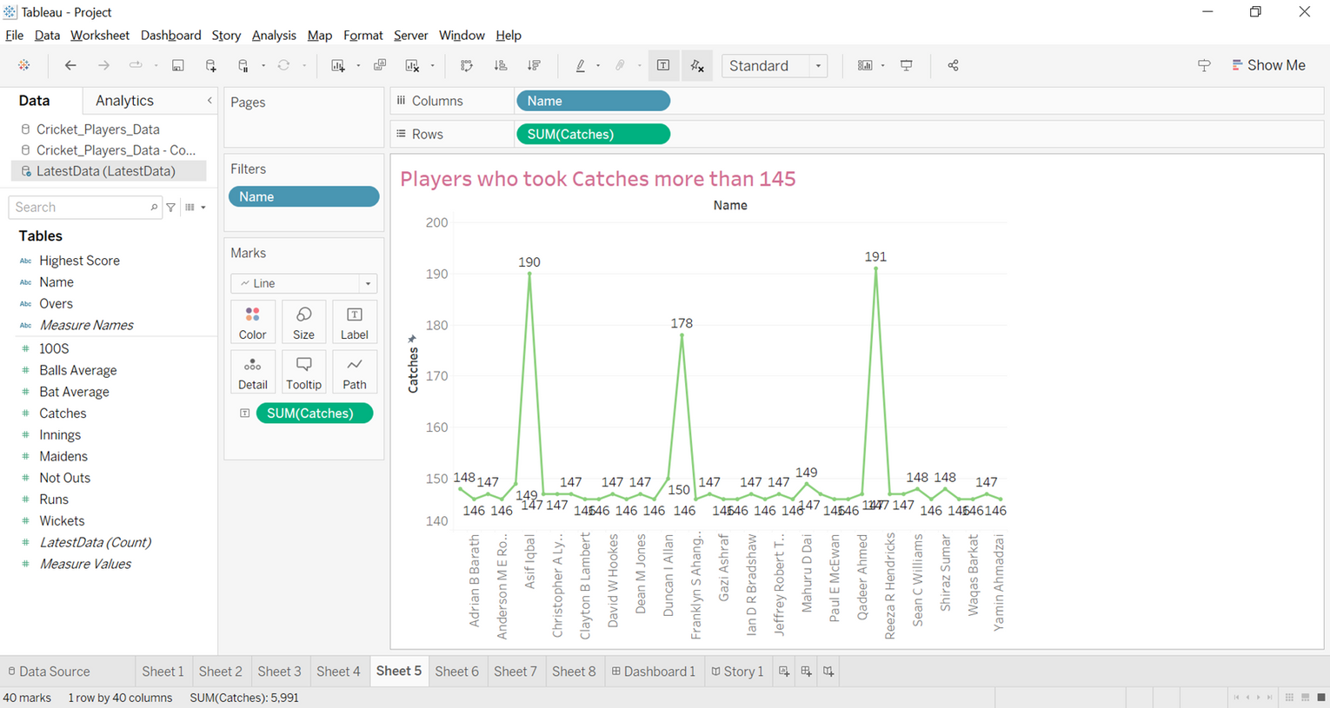
Goal 5
To visualize all the players whose took more than 145 catches.

Slide 18
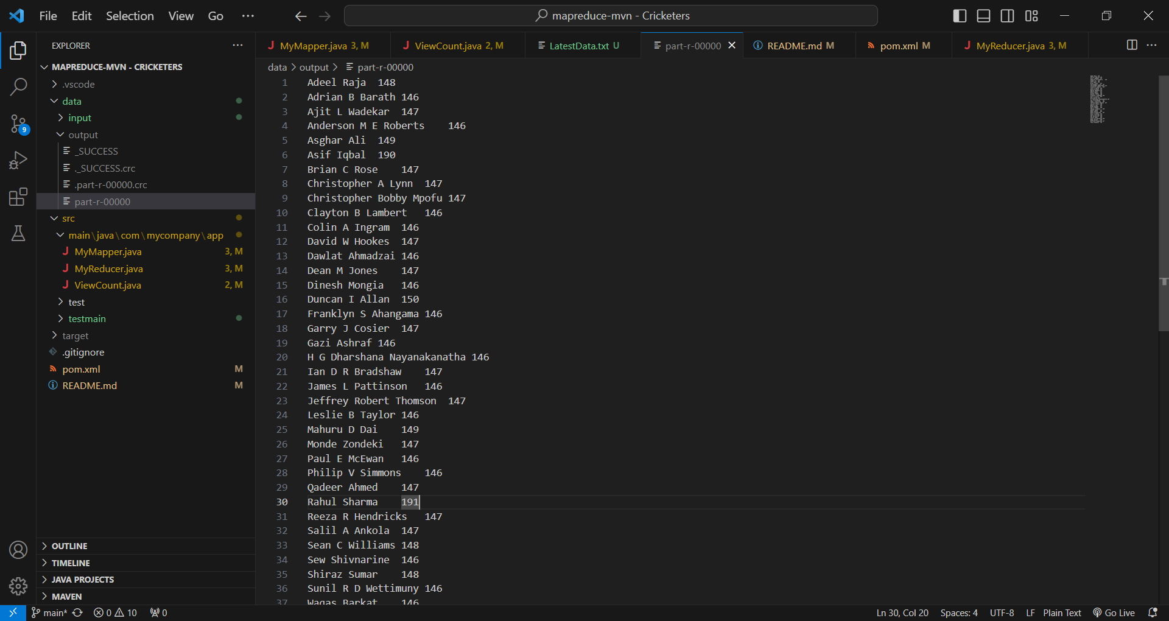
Goal 5(MapReduce Output)

Slide 19
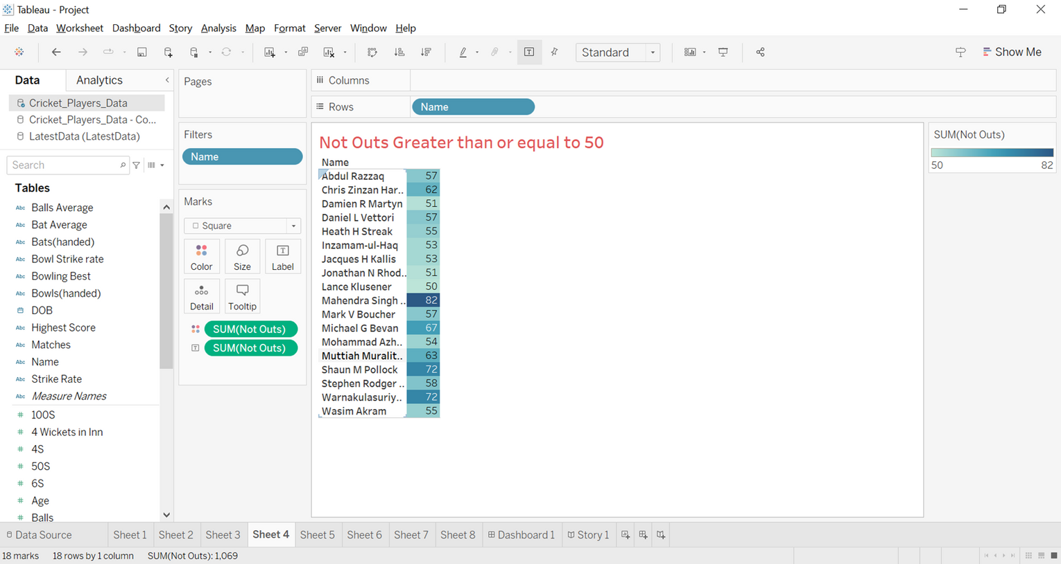
Goal 6
The goal is to visualize all the players who remained not out in more than 50 matches.

Slide 20
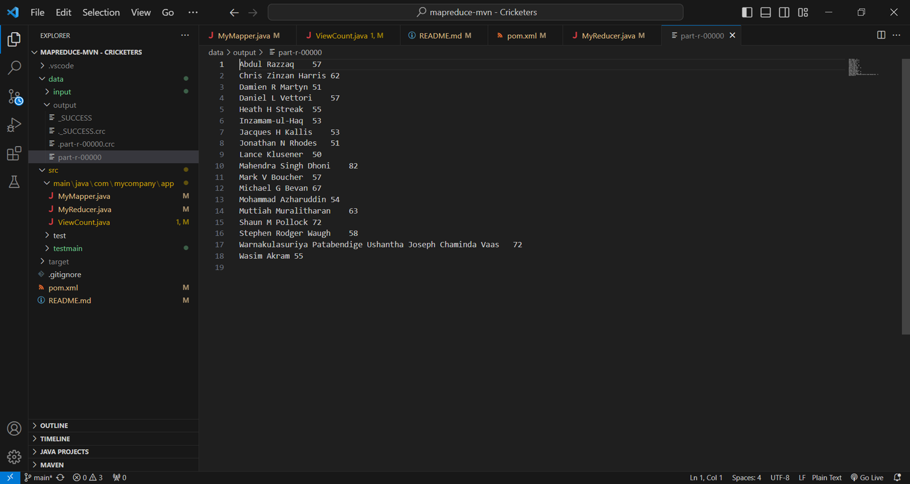
Goal 6(MapReduce Output)

Slide 21
Challenges Faced
01
One of the main challenges we faced was cleaning and preprocessing the data. The dataset was large and complex, and there were some inconsistencies in the data. We overcame this challenge by carefully reviewing the data
Another challenge we faced was identifying the best key performance indicators (KPIs) for each department. There are many different ways to measure performance in cricket, and we had to carefully consider the specific goals of our project when selecting the KPIs.
02

Slide 22
Conclusion
Cricket has a history of great players who are good at both hitting and throwing, like Kohli, Root, and Rohit. With over 150 clean overs, bowling greats Pollock, McGrath, Kapil, and Muralitharan show how smart they are at strategy. Scorers of hundreds like Kohli, Tendulkar, de Villiers, and Gayle add to the fame, and wicket-takers like Muralitharan and Akram describe skill. Adeel Raja and Adrian Bharath, who have each caught over 145 balls, are great at fielding. Along with Pollock and Vas, Dhoni is the only player who has not been out in more than 50 matches, which shows how tough he is. Together, these players raise the bar for greatness in cricket and add to its rich patchwork.

Slide 23
Thank You

